Slide 1
Protectly
DRP28 - James Ball, Lukasz Jakubowski, Adam Gould, Noor Sawhney

Slide 2
Safety is a problem
Especially at night.

Slide 3
63%
of UK women feel unsafe when walking alone at night (1)
33%
of UK men expressed the same concern (1)
61%
of all violent incidents occur at night (2)
[1] https://plan-uk.org/media-centre/almost-two-thirds-of-women-feel-unsafe-walking-alone-after-dark
[2] https://www.churchillsecurity.co.uk/2019/06/27/how-dangerous-is-a-night-out-in-britain/

Slide 4
63%
of UK women feel unsafe when walking alone at night (1)
33%
of UK men expressed the same concern (1)
61%
of all violent incidents occur at night (2)
[1] https://plan-uk.org/media-centre/almost-two-thirds-of-women-feel-unsafe-walking-alone-after-dark
[2] https://www.churchillsecurity.co.uk/2019/06/27/how-dangerous-is-a-night-out-in-britain/

Slide 5
63%
of UK women feel unsafe when walking alone at night (1)
33%
of UK men expressed the same concern (1)
61%
of all violent incidents occur at night (2)
[1] https://plan-uk.org/media-centre/almost-two-thirds-of-women-feel-unsafe-walking-alone-after-dark
[2] https://www.churchillsecurity.co.uk/2019/06/27/how-dangerous-is-a-night-out-in-britain/

Slide 6
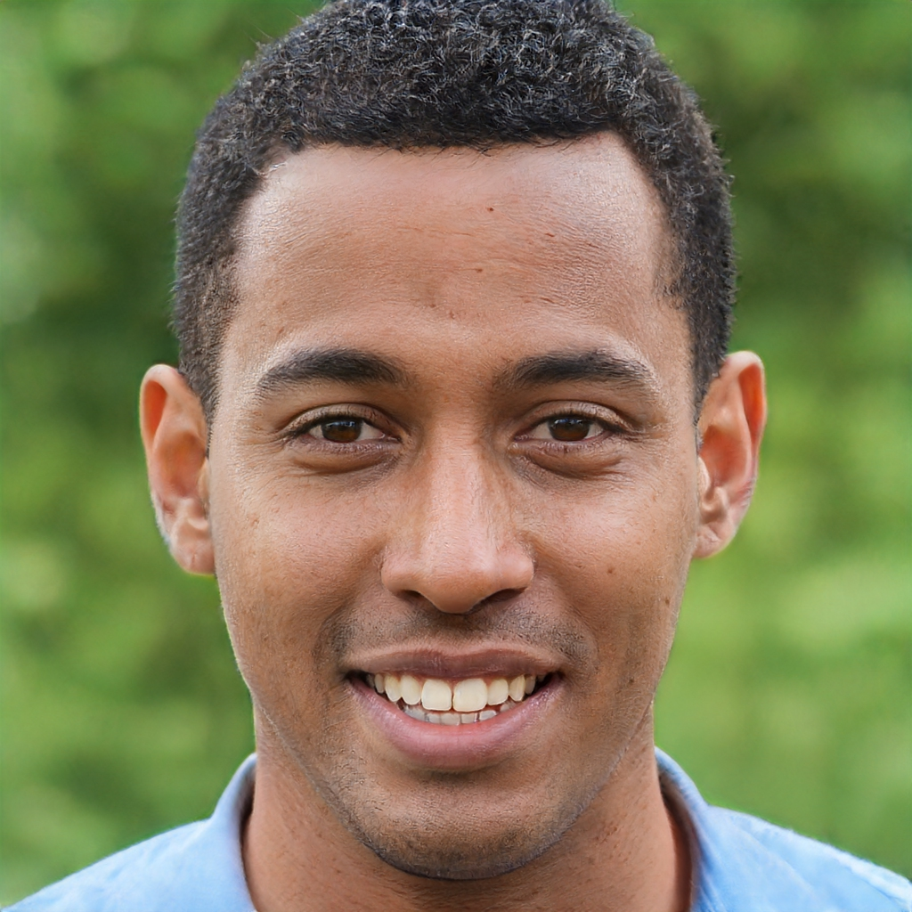
Markus, 22
Anna, 20
Graduate in Manchester
Student in London
“I’ve lost my friends several times during nights out”
“I don’t feel safe at night in the dark, especially by myself”
Frustrations:
Can’t enjoy parties while friends lost
Worried about drunk people
Wants to:
Go out in a group
Be able to check if friends ok
Have a way to arrange events safely and easily
Frustrations:
Feels lonely
Has to travel on her own
Pandemic affected many of her relationships
Wants to:
Feel sociable again
Enjoy her time in the city
Feel comfortable during and after parties

Slide 7
Facilitating the physical wellbeing and safety of 18-25 year olds during and after nights out to clubs and bars.

Slide 8
“I feel out of control of a situation when I’m drunk”
“I’m an easier target when drunk”
Digging deeper into concerns
“I’d feel more confident with more ways to reassure my safety”
“Really scared and worried for my friend’s wellbeing”

Slide 9
Tools to take control
“A panic button that could not just make a noise but alert my friends”
“I’d love a way to pretend to receive a phone call”
“I want an outside source to know where I am”

Slide 10
Our Solution
A mobile application to strengthen and facilitate the personal and group safety of young people
Intuitive and easy safety features to reassure and eliminate wellbeing concerns, even when drunk
Live tracking of friends, accessible panic button with fake phone call and SOS alerts

Slide 11
Video:
https://docs.google.com/file/d/1TkSbP_baJ6-AdFkQlJtX-KBgsVjFHOZp/preview
Music: www.bensound.com
Notes:
Welcome to the Show by Kevin MacLeod
Link: https://incompetech.filmmusic.io/song/4614-welcome-to-the-show
License: https://filmmusic.io/standard-license
Carpe Diem by Kevin MacLeod
Link: https://incompetech.filmmusic.io/song/3478-carpe-diem
License: https://filmmusic.io/standard-license
www.bensound.com

Slide 12
Markus and Anna's old journey
Status of friends unknown before the night out
Markus feels...
Anna feels...
Takes ages for friends to find each other when they arrive
Unsafe and anxious journey back home
Anxious of the whereabouts of his friends
Worried about people getting home safely
Stressed about why she can't get in contact with her friends
In danger when she is walking home on her own

Slide 13
Markus
New journey
Anna
Tracking of friends location and battery so nobody is lost
Able to alert friends when in danger, even when tipsy
Safest route home is recommended, and tracked

Slide 14
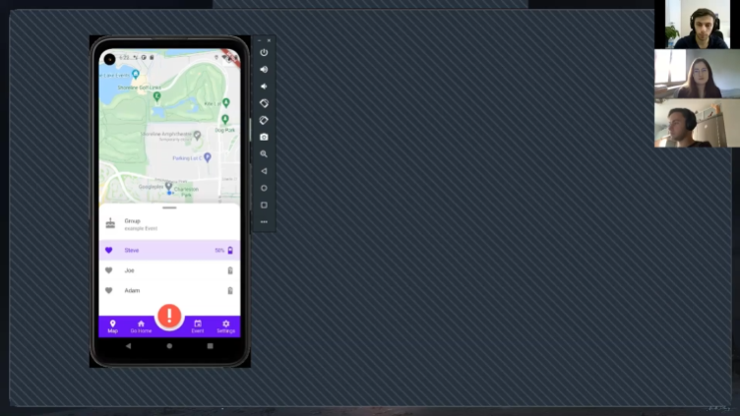
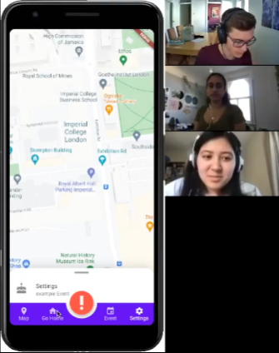
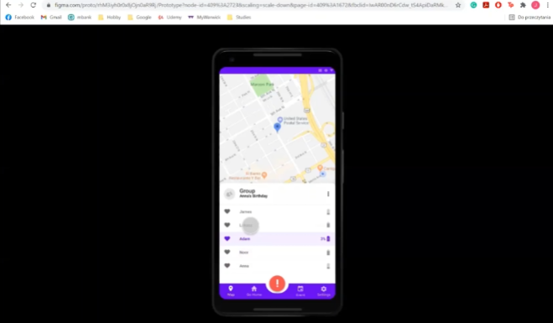
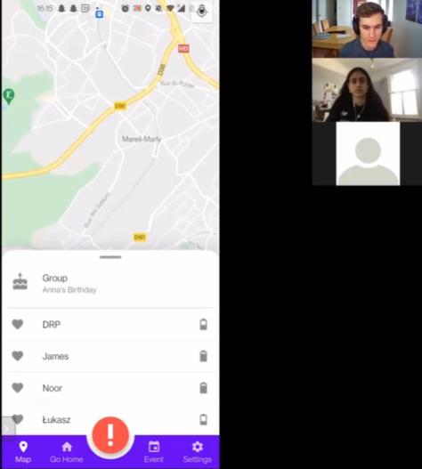
Continuous User Feedback
Held over 20 interactive interviews during prototyping and development
Every interview fed the next iteration of changes
“The alert your friends button...quite an important one to have next”
“It’ll good to be able to see their location and alerting them would be the key thing to do.”
"It would be cool if when it went below a certain point it went red"

Slide 15
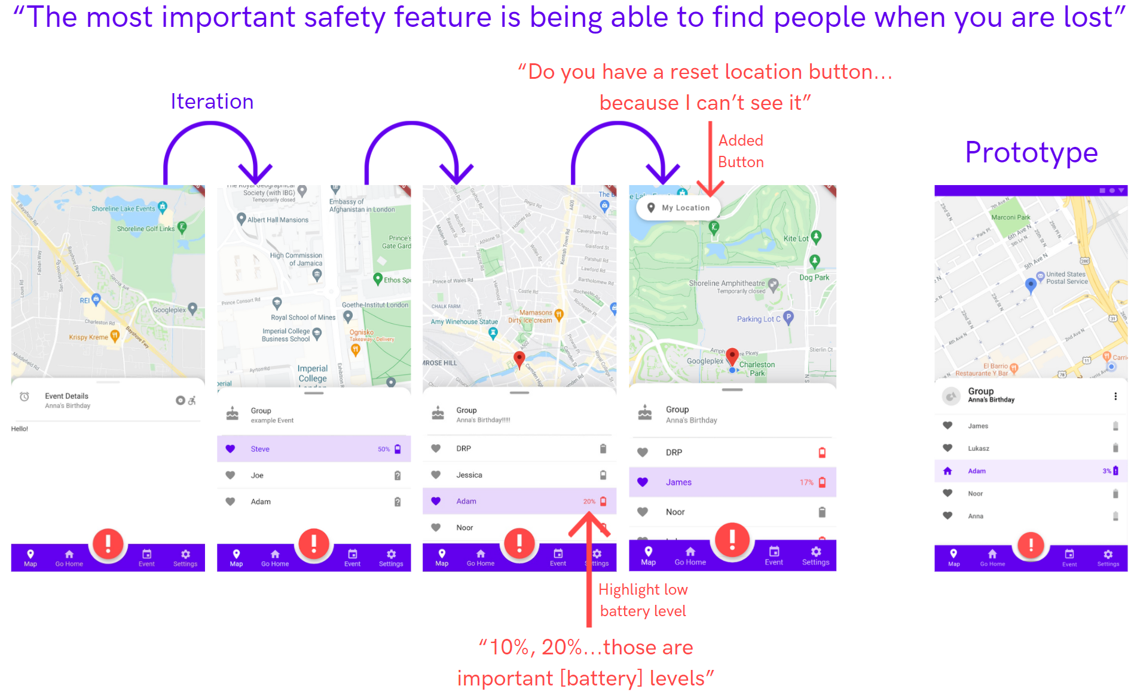
Iterative development

Slide 16
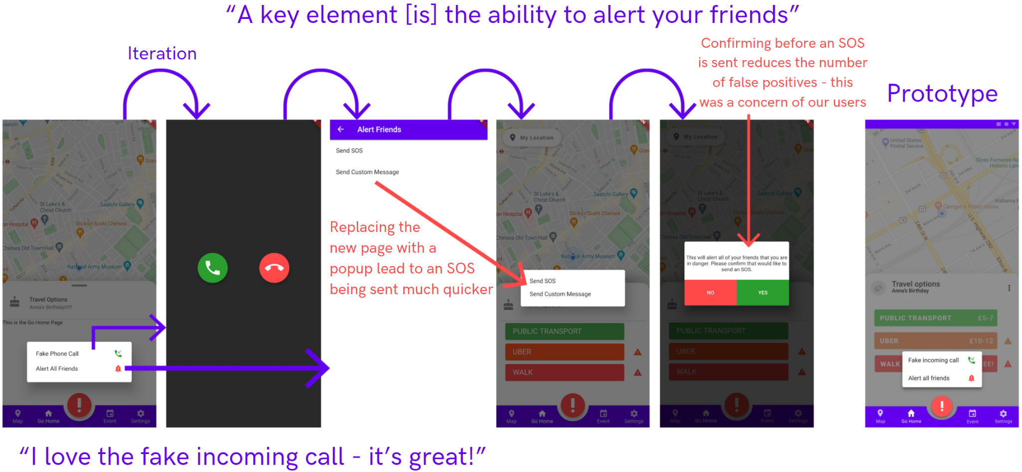
Iterative development

Slide 17
Quantitative Testing
Possible quantitative measures
Time taken to create an event
Time taken to send an alert to all friends
Dropout rate when creating events
Time taken to track a specific friend
Time taken to change home location

Slide 18
Time taken to send an alert to all friends
“A key element [is] the ability to alert your friends”
Interviewees repeatedly expressed their interest and need for a way to quickly alert their friends

Slide 19
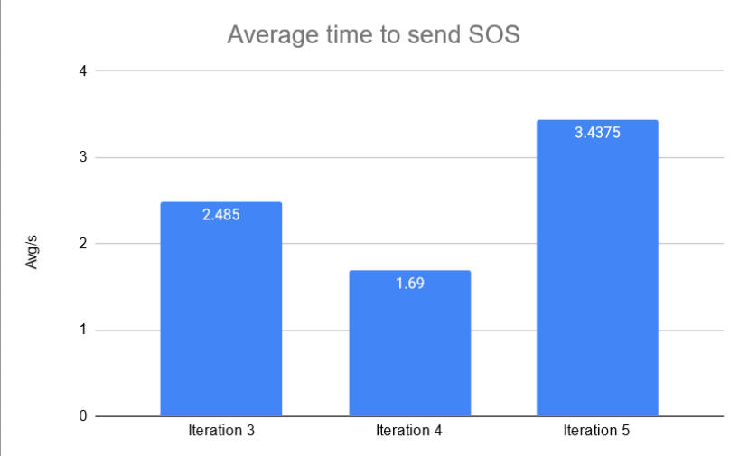
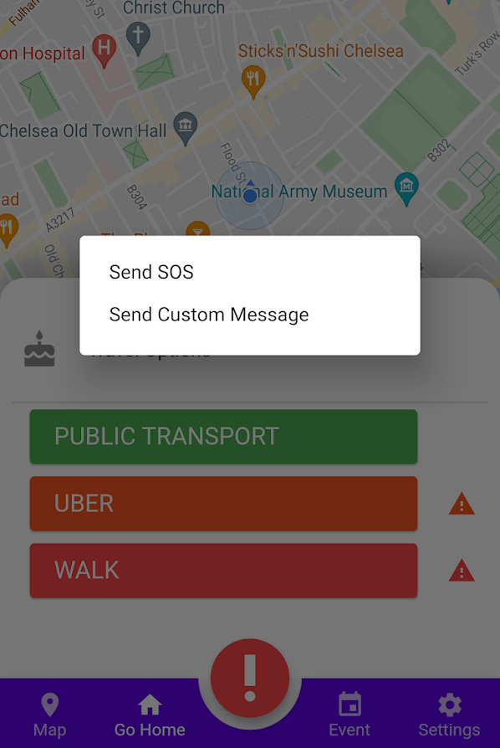
Time taken to send an alert to all friends
A balance was needed between speed and reducing false positives
We changed the new page into a popup to reduce time
We added a confirmation to reduce false positives
After
confirmation
added
After
pop-up added
Change
to pop-up

Slide 20
Flutter App
UI Screen
Phone Interactions
Functions
States
Android
BLoC
Requests
Responses
Data Repos
HTTP requests
Heroku
Gunicorn Web Server
SQLAlchemy
PostgreSQL Database
Flask API

Slide 21
Flask API
Heroku
Gunicorn Web Server
SQLAlchemy
PostgreSQL Database
Flask API
Protectly interacts with the database via a RESTful API implemented using Flask
Flask is a 'microframework' which means development is simpler and feature bloat is minimised
Chosen over alternatives such as Django as it is lightweight and no html-based frontend is required

Slide 22
PostgreSQL Database
Heroku
Gunicorn Web Server
SQLAlchemy
PostgreSQL Database
Flask API
Heroku offers a PostgreSQL database instance to be attached to the Flask backend
GitLab CI allows for a temporary PostgreSQL database to be used for testing the backend
Database migrations setup so that future changes to the data model in Flask are easily reflected on the database

Slide 23
Flutter
Flutter App
UI Screen
Functions
States
BLoC
Requests
Responses
Data Repos
Compatible with many devices
Declarative UI programming style in Dart
Vast support from a variety of community libraries
Simplified the development process by providing built-in widgets that were easy to customise and modify
Development with Android/IOS SDK’s limit the implementation to a single platform and don’t provide a UI-kit as extensive as flutter’s

Slide 24
Front-end Architecture
Flutter App
UI Screen
Functions
States
BLoC
Requests
Responses
Data Repos
Data Repositories interact with the restful API on the Heroku Server
The Business Logic Component (BLoC) pattern used to separate the model from the view
As the model changes, the view does too
UI components designed as separate, reusable widgets

Slide 25
Flutter Data Repositories
User Repo
User Model
Event Model
Event Repo
getUser()
Name
ID
getEvent(id)
Email
Group
Phone No.
Owner
Battery Level
Name/Desc
Flutter App
UI Screen
Location
Date/Time
Functions
States
BLoC
Home Location
Location
Requests
Responses
Data Repos

Slide 26
Flutter
Business Logic Component (BLoC)
States
Request
UI Screen
BLoC
Data Repos
Functions
Response
Flutter App
UI Screen
Functions
States
BLoC
Requests
Responses
Data Repos

Slide 27
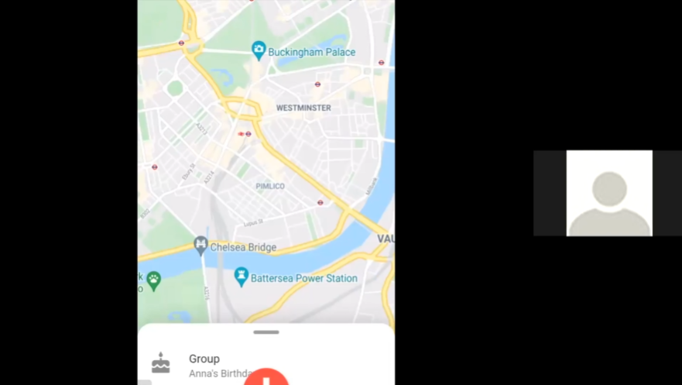
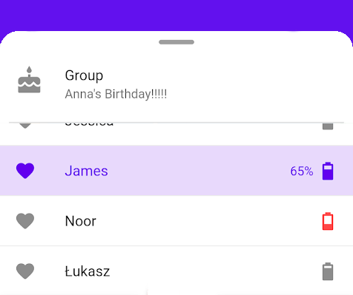
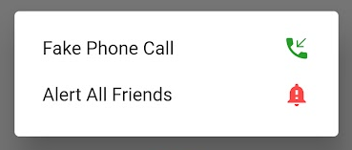
Flutter UI Screen
Flutter App
UI Screen
Functions
States
BLoC
Requests
Responses
Data Repos
Interviewees thought...
“It all works as intended and it’s very intuitive!"

Slide 28
What went well
Surveyed and interviewed dozens of young people
We exposed them to various conditions:
At home
While out with friends
While running
Learned a new framework (Flutter) from scratch
Designed a nice logo for it :)
(Protection, Emergency, Tracking)

Slide 29
Impact and benefits
Anna is now more confident on her night out
Markus does not have to constantly worry during an event
“Now I can enjoy the party and not think about going home!"
“The most important safety feature is being able to find people when they are lost”
Anna can now be tracked by her friends when she's out
She can alert them in case of emergency
She can take a fake phone call when uncomfortable
“I love the fake incoming call!”
Markus can plan the event
Markus can't lose his friends
He knows their battery life
"Tells the battery percentage when you click on name, that's useful"
He is notified when something bad happens

Slide 30
What have we learned
Not to work in a bubble/void
Stakeholders can have wildly different ideas than we do
Basic prototyping
“All works as intended and it’s very intuitive!”
Trello helps keep work organised
Flutter, Flask, Canva
“How the battery is loaded is nice”

Slide 31
What we would do differently
More real-world testing in groups
Testing at night
Testing whilst drunk
Focused on using Kanban/Trello from the beginning
Maintain user stories throughout

Slide 32
Future
Providing support for iOS
"I want it on my iPhone!"
Publishing the app
Battery consumption
"I would like the app to be efficient,
so my phone is on in an emergency"
Securing user data
Web interface (for planning) - Markus
Implementing current status of users
Alerting
Going home
On a walk etc.

Slide 33
Thank you for your attention!
Protectly

